Slide 1
Microsoft Power Platform + Dynamics 365
Notes:
Hi, Welcome to Microsoft Power Platform + Dynamics 365 Bootcamp.

Slide 2
Day 5: Power Packed Bizz Apps Day– Finance & Supply Chain Part II

Slide 3

Agenda
Introduction
Technology Modernization
Modern Finance
Supporting modern supply chain management
Demo
How to embed Power Platform in Dynamics 365 for Finance and Supply Chain

Slide 4

Trending technology advancements
Modern Finance
Machine learning to analyze payments
Integration of existing applications with cloud services
Omnichannel customer experience
Supply Chain Management
Improvement of IoT devices and applications
Supplemented use of AI and robotics
Advanced sensor and monitoring capabilities

Slide 5
Microsoft is taking a focused approach to modernize finance and supply chain
Technology Modernization
Modernize Finance
Operational innovation
Stay ahead of the competition with modern, unified, intelligent, and adaptable tools and technologies that match your business’ needs.
Transform finance with automated and integrated global financial processes leveraging predictive analytics and machine learning for intelligent recommendations.
Automate and streamline supply chain management with predictive insights that proactively respond to your business demands.

Slide 6


Dynamics 365
The world’s connected AI business cloud
Sales
Talent
Marketing
Finance
Service
Supply Chain
Commerce
Project Service Automation
Power Platform

Slide 7

Technology Modernization

Slide 8
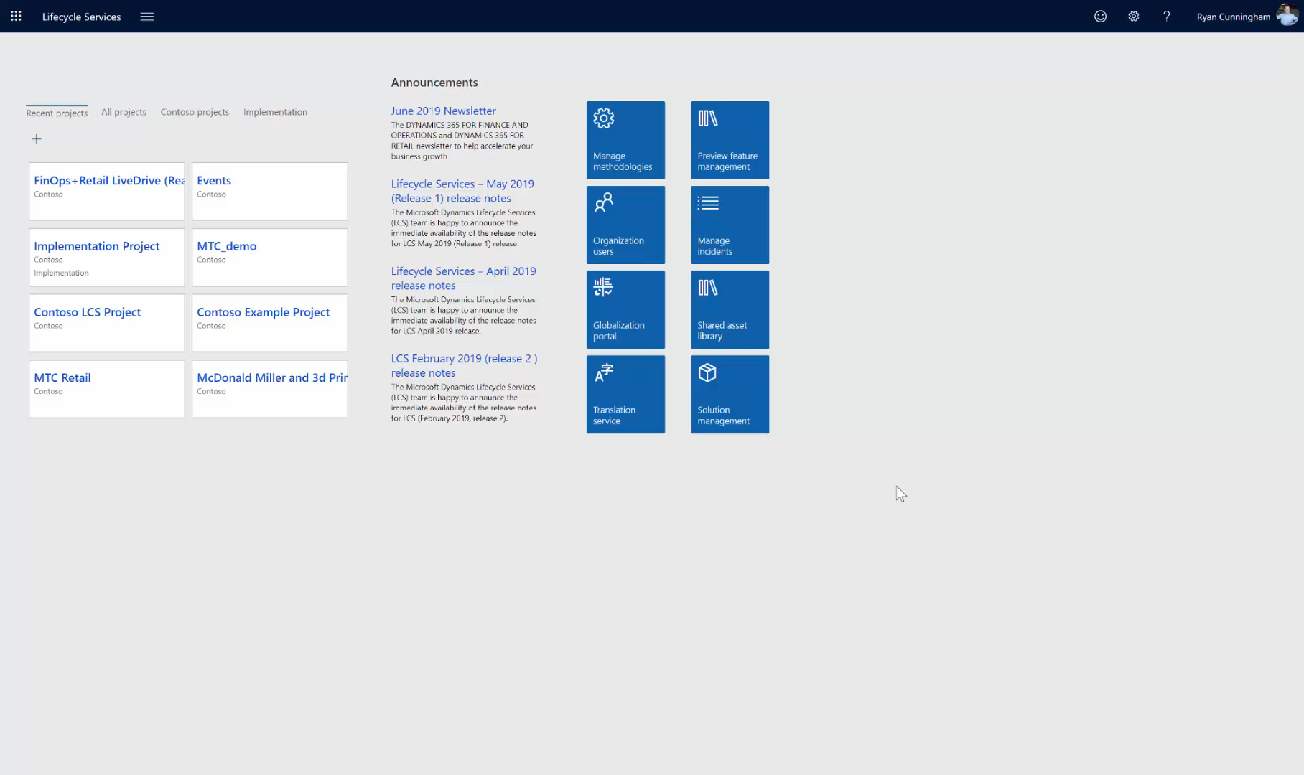
Dynamics 365 implementation and governance:
Lifecycle Services
Manage Dynamics 365 Finance & Supply Chain management – Collaborative workspace
Manage methodologies, localization and business processes
Use for projects from pre-sales to implementation
Maintain and monitor environments

Slide 9
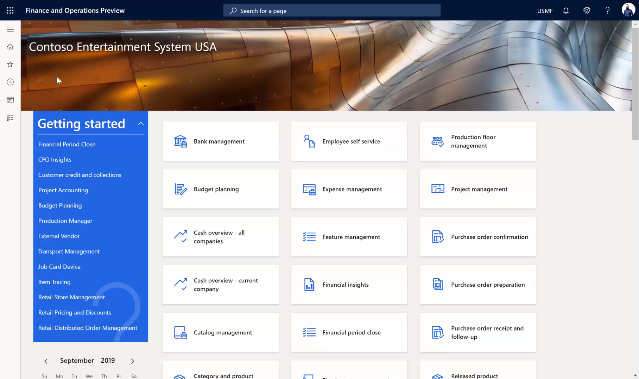
Enable effective actionable insights:
Business intelligence with Microsoft Power BI
Derive actionable insights from transactional and observational data
Create a data culture where every employee can make decisions based on facts, not opinions
Create composites of reports from various other Power BI content, such as actuals and budget balances from general ledger
Provide Power BI dashboards in context to roles

Slide 10
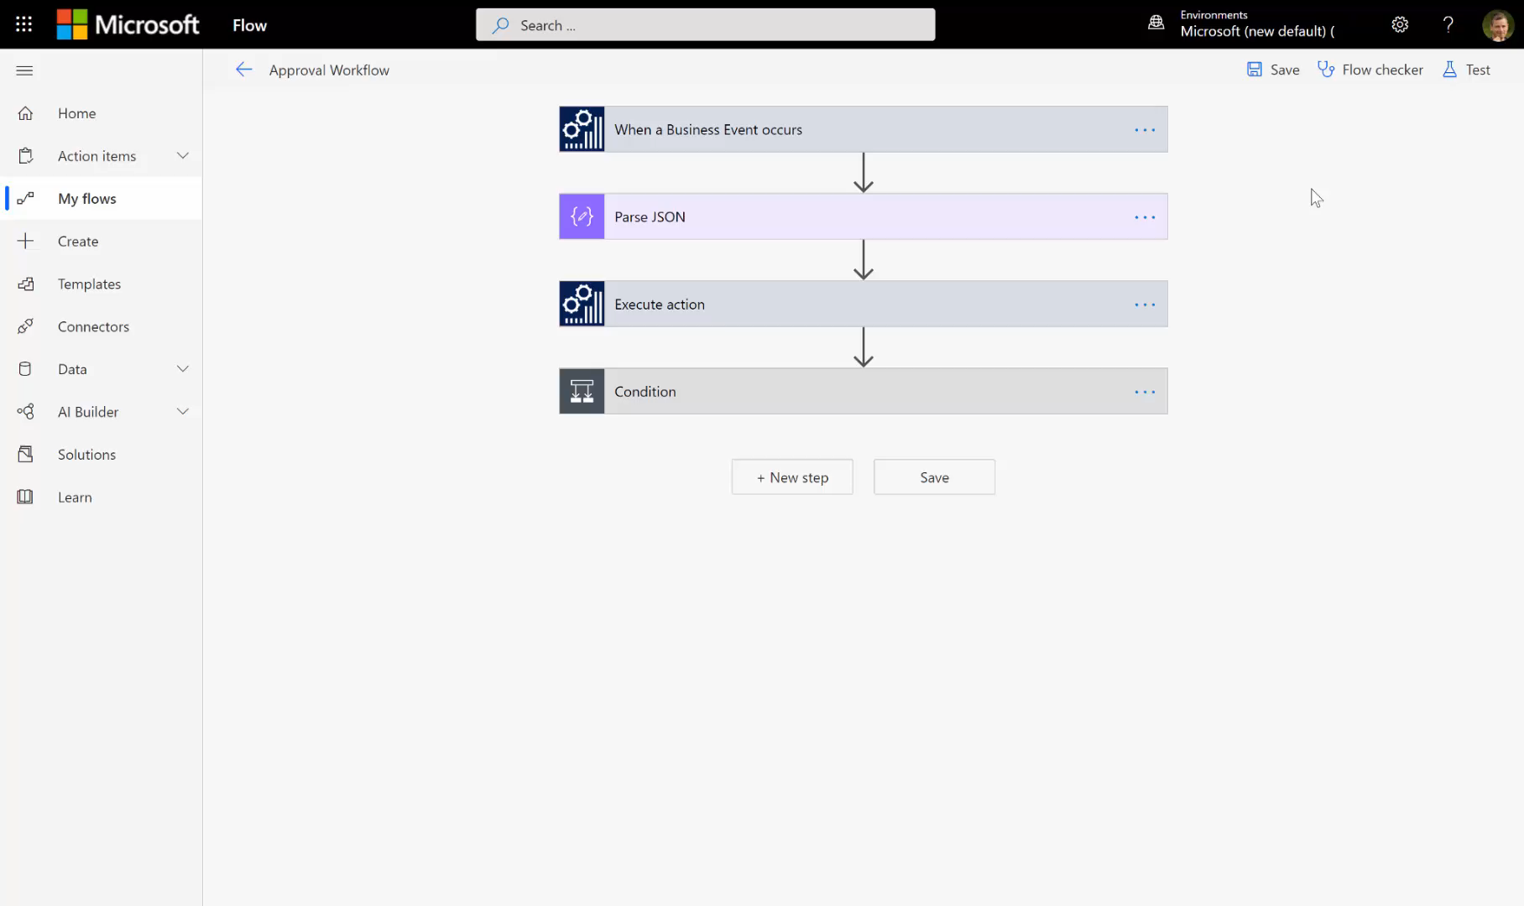
Personalize your finance management requirements:
Unify data and processes with Microsoft Power Platform
Easily connect and unify your data from popular data sources using prebuilt connectors
Use business events to trigger workflows within Dynamics 365 Supply Chain Management or create action activities in Flow or Azure Messaging Service.
Create custom entities, populate them with business data using Power Query, and build rich applications with PowerApps
Utilize new dual-write integration services for a seamless data exchange between Dynamics 365, utilizing the Common Data Service (CDS)

Slide 11
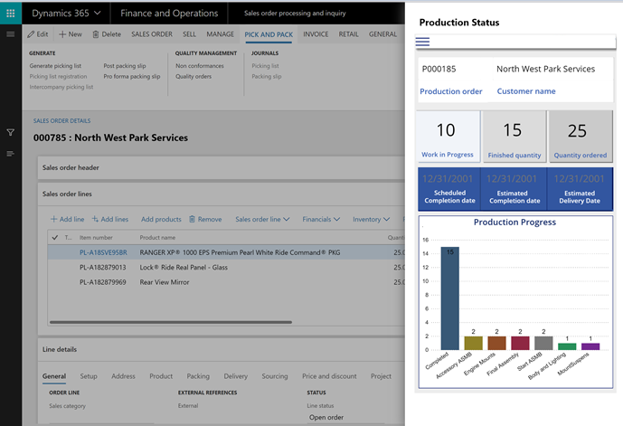
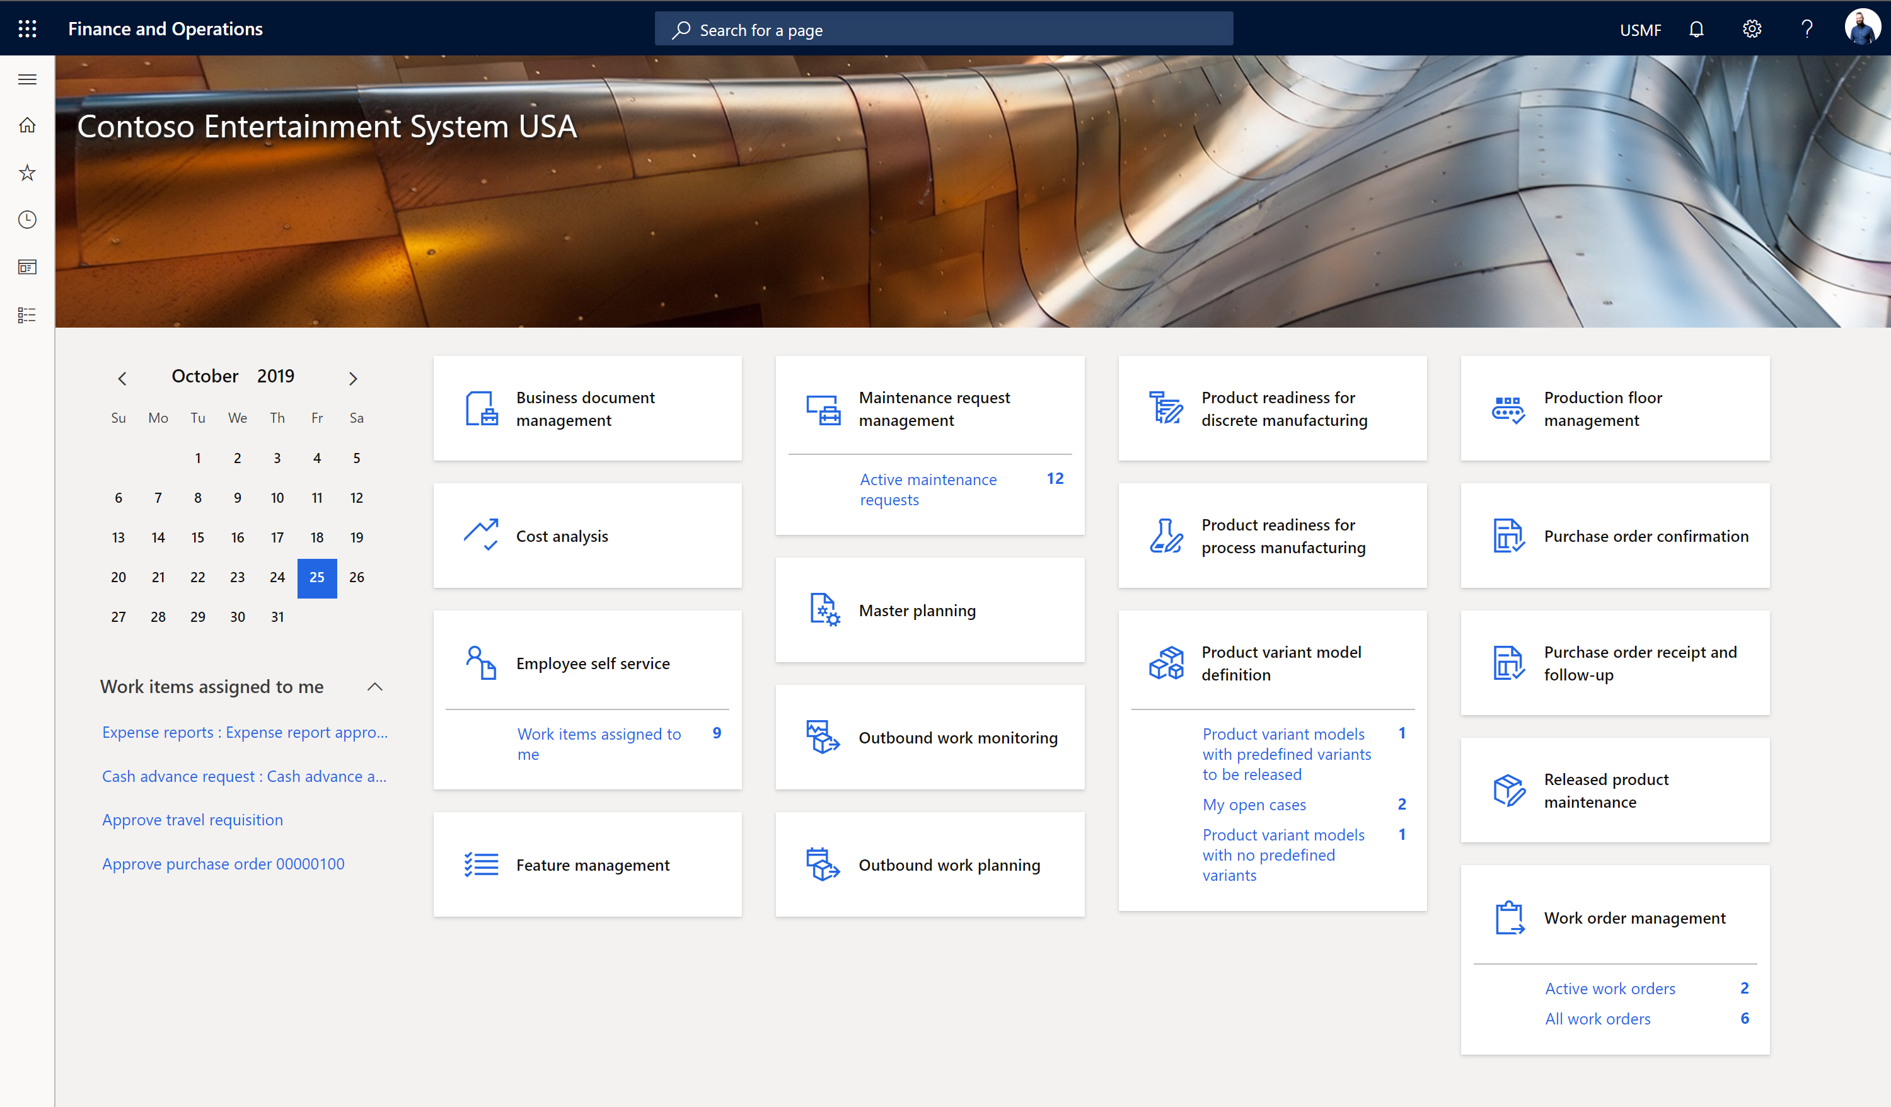
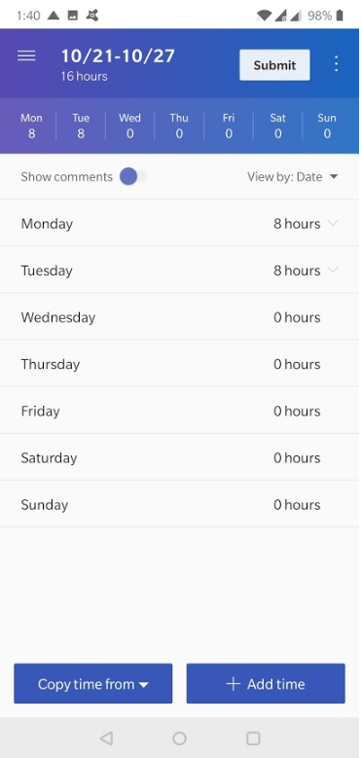
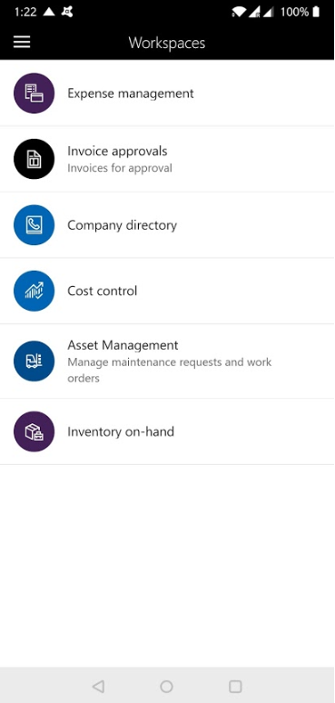
Build and deploy scalable web and mobile client apps:
Mobile Choice
Choose correct tool for Task, Native mobile client, Power App or Xamarin
Enable access to important reports, wherever and whenever you need them.
Build no-code or low-code apps within PowerApps or using Azure SDK.
Ensure data consistency across apps, regardless of how users choose to access data.
Option to embed Power App within UX

Slide 12
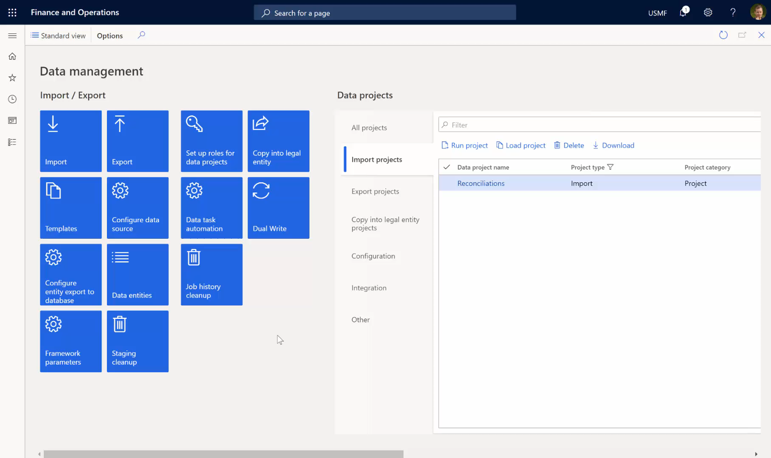
Enable effective business processes:
Integration unification
Connect and unify your data with ease and use prebuilt connectors
Create custom entities
Common Data Service and Dual Write
Data Management Suite
AppSource.microsoft.com

Slide 13
Why Microsoft Business Applications?
Build and grow a practice quickly with industry-leading innovation
Lead with innovation
Build on your strengths
Broaden your reach
Modular, highly customizable apps built on a unified platform of common data services, AI, and business intelligence can help you differentiate your offerings.
Microsoft makes it easier to enter new markets using the Microsoft development and management tools you already know.
Accelerate business results with Microsoft partner marketing resources that increase the impact and visibility of your services.
Notes:
To keep this super simple, we’ve narrowed it down to three main benefits: We give you industry leading innovation, we allow you to build on your strengths with tools you already know, and we help you broaden your reach, so you can grow even faster. Let me quickly dive into these three areas a little more.

Slide 14


Lead with Innovation
“We chose to partner with Microsoft because we trusted that they would constantly innovate and offer the industry-leading solution set.”
Sam Dharmasiri, Director, eBECS
“Partnering with Microsoft is the best bet if you want to future-proof your company. Their investment in innovation is unparalleled.”
Christian Hutter, Principal, RSM

Slide 15





Microsoft Business Applications ecosystem
Intelligence
Data
Marketing
Modern
Unified
Talent
Sales
Intelligent
Adaptable
Microsoft Dynamics 365
Operations
Retail
Finance
Service
Power Platform
Power BI
Flow
PowerApps
Notes:
Our Business Applications Platform, and surrounding ecosystem, is comprised of a suite of business applications to support all types of businesses across a range of industries and lifecycles. Today, we’re specifically talking about Finance and Operations, but it’s important to know that this is just one component in our ecosystem that is all designed and built to work together.
Beneath our applications, we have the Power Platform, which connects to our Common Data Service and provides a common set of development, logic, and BI tools that Partners can access to extend our existing Dynamics 365 apps or build their own apps. More on this later, but first, let’s discuss the business opportunity.

Slide 16
Building a Dynamics 365 for Finance and Operations practice
Adapt quickly to changing market demands and drive rapid business growth.
Elevate your financial performance
Run smarter with connected operations
Automate and streamline your supply chain
Innovate with a modern and adaptable platform
Simplify configuration of your regulatory services

Slide 17
Recognized Leader
Nucleus Research ERP Technology Value Matrix
Core success factors
Focus on usability, productivity, and interoperability
Microsoft’s cloud platform (Azure)
Lifecycle Services
Extensibility (enabling users as well)
Deployment options
The value Matrix is an assessment of the state of the market and indicates the functionality and usability of a solution. An arrow indicates future movement of a solution relative to others. Solutions without an arrow are projected to keep pace with the increase in functionality and usability expected in the overall market.
www.dynamics.Microsoft.com/en-us/analyst-awards
Notes:
And you don’t need to take our word for it. Nucleus Research has recognized Microsoft as a Leader in the ERP Technology Value Matrix.

Slide 18


Build on your strengths
“With best-in-class cloud offerings on Dynamics 365, we’ve become a more competitive business, because we deliver services tailored to the unique needs of these vertical markets from a suite of streamlined business applications.”
Whit McIsaac, CEO, Americas, SAGlobal
“The breadth of capability you get with the Microsoft platform is amazing. Between Dynamics 365, Azure, and Power Platform, you nearly have it all.”
John Pence, Founder, Sunrise Technologies

Slide 19


Broaden your reach
“Microsoft’s support of our go-to-market efforts, both at the regional and corporate level, has been instrumental to our growth.”
Rik Dubbink, Partner, CRM Partners
“Dynamics is the lifeblood of everything we do. It’s the beating heart of our clients’ customer experience, it’s the way they optimize their operations and increase staff productivity, all helping them stay ahead of their competition.”
Steve Scarbrough, General Manager, Dynamics, Intergen

